Slide 1
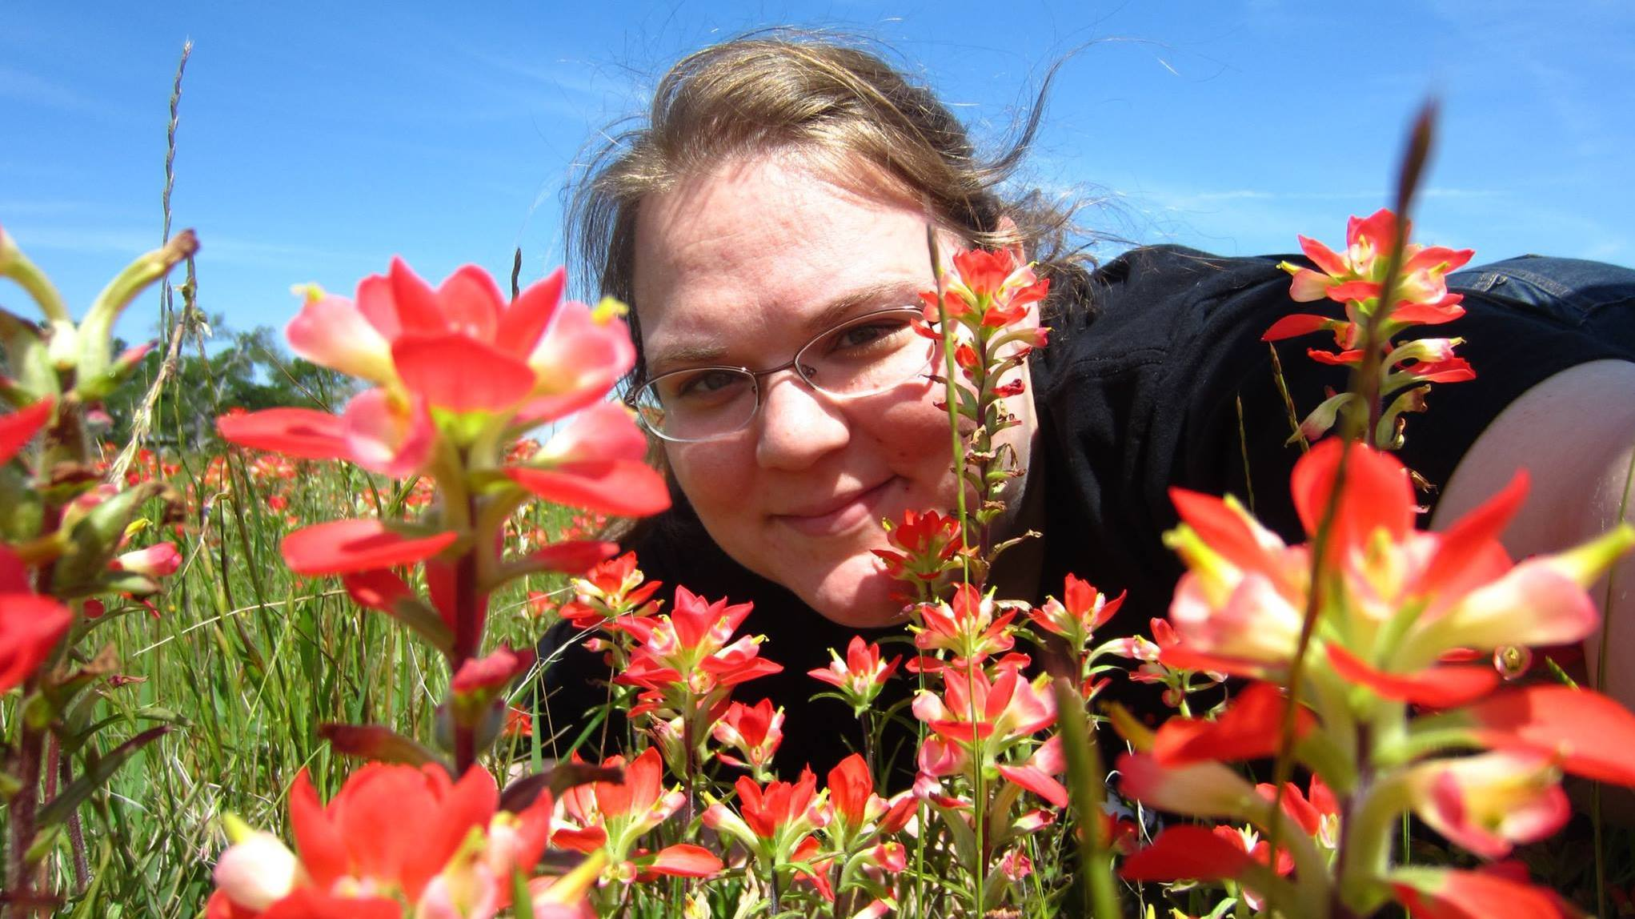
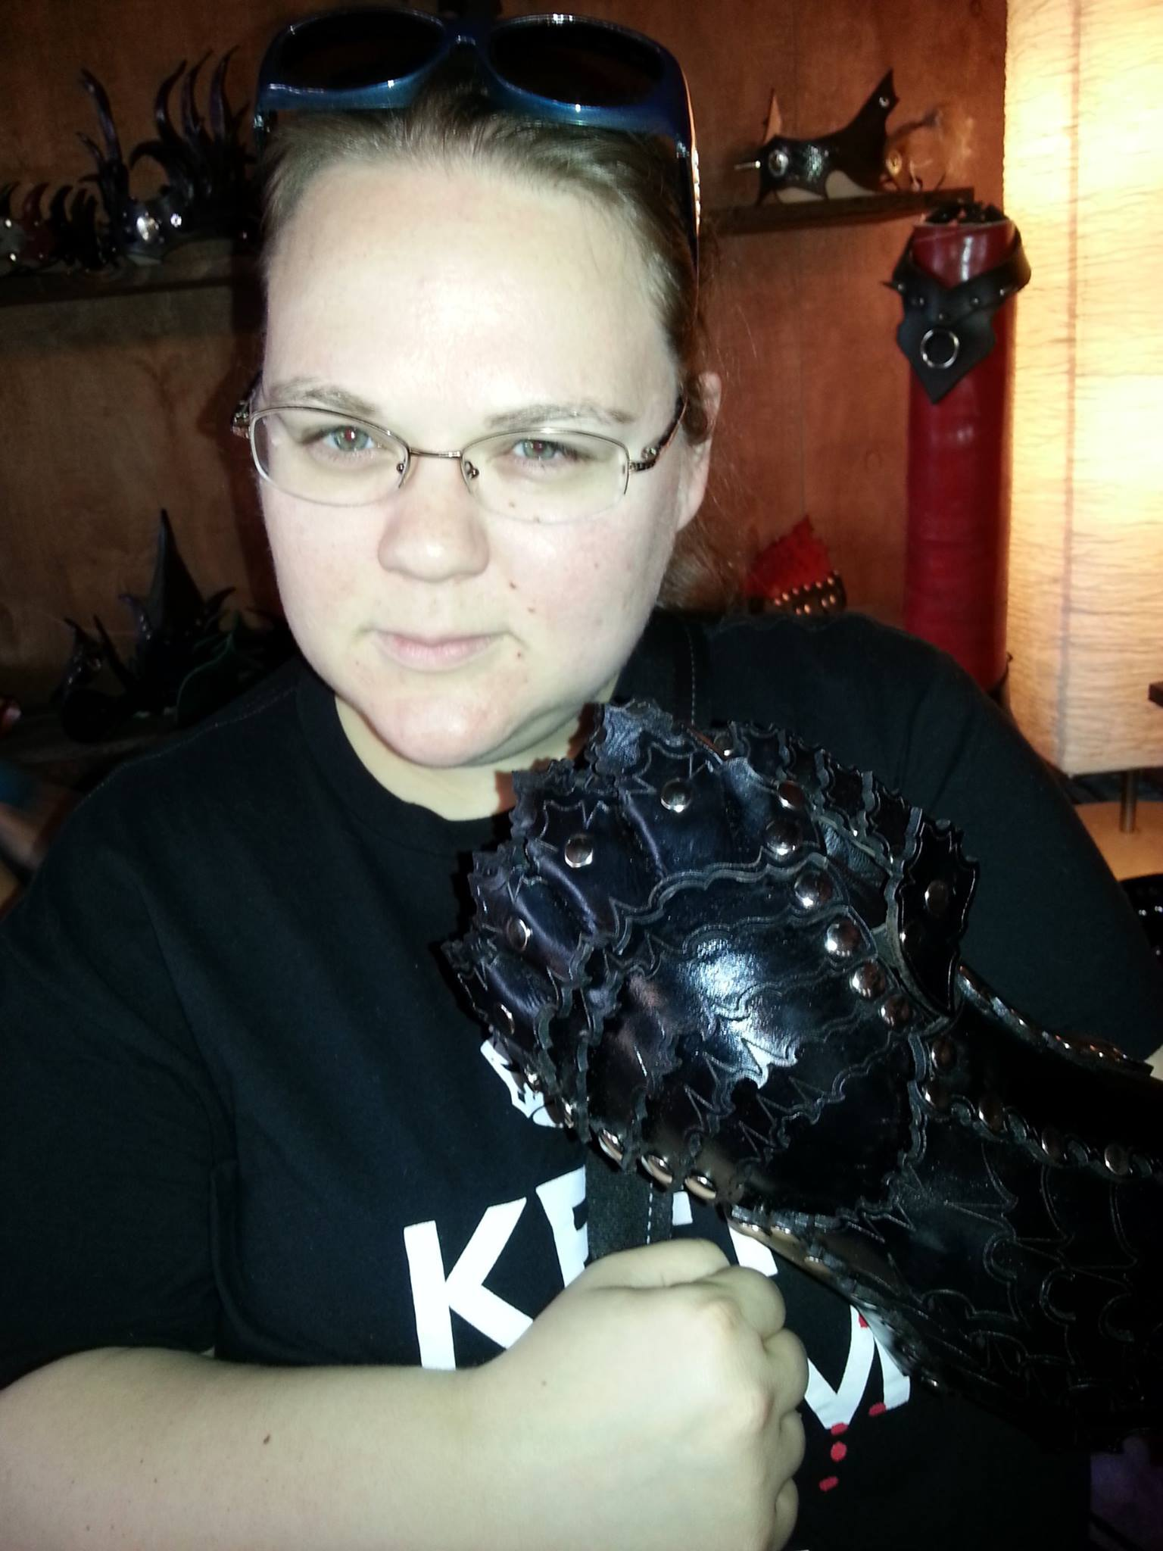
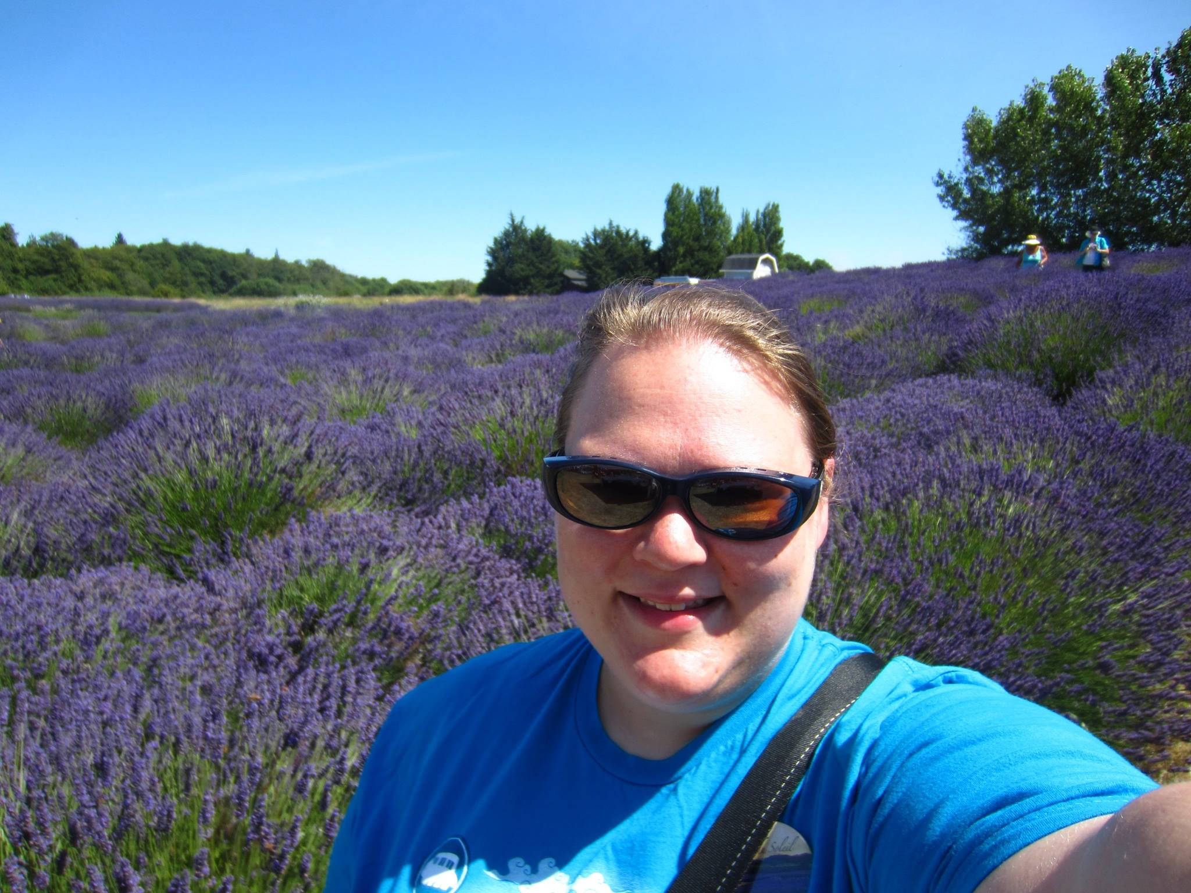
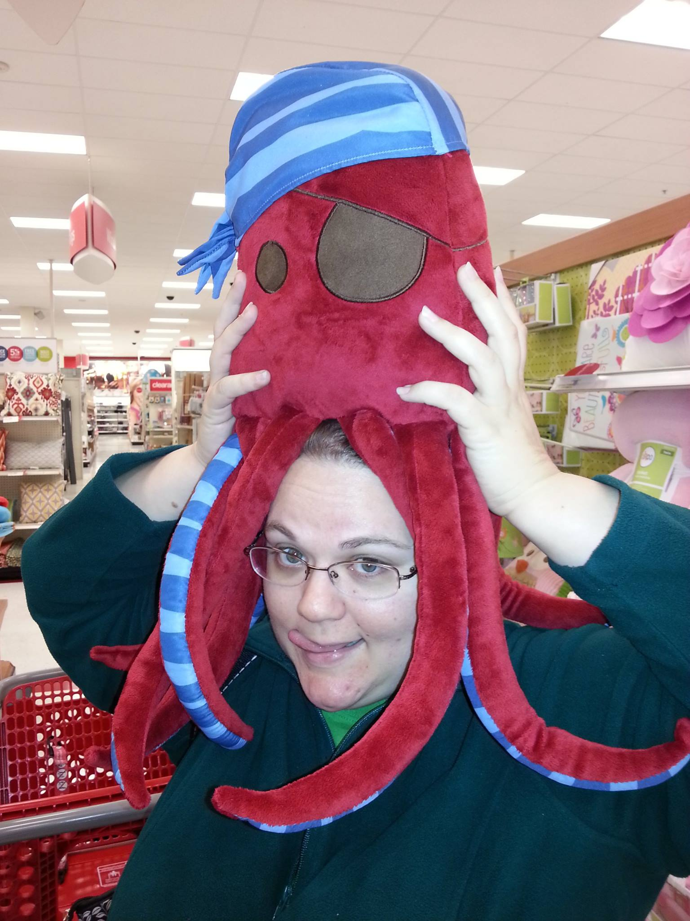
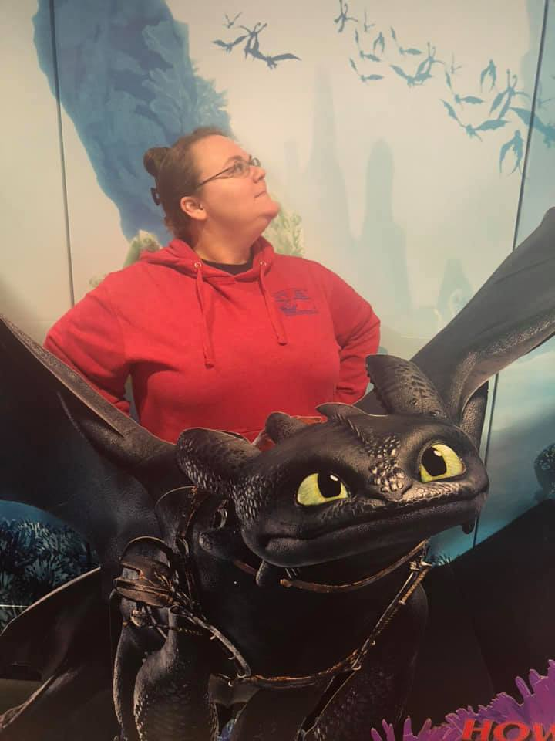
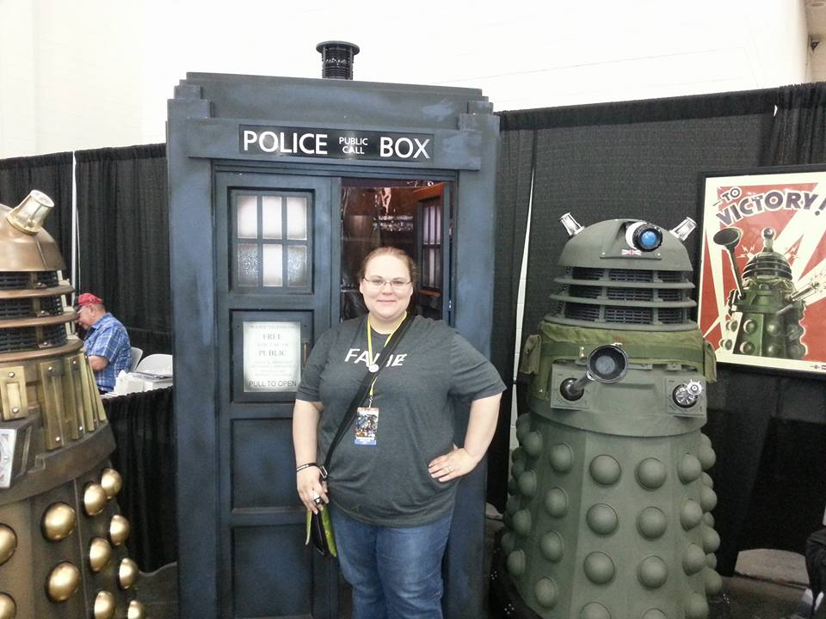
Meet Ms. Davis-Owen

Slide 2
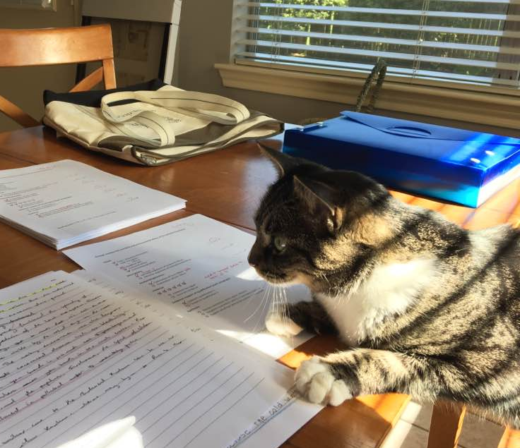
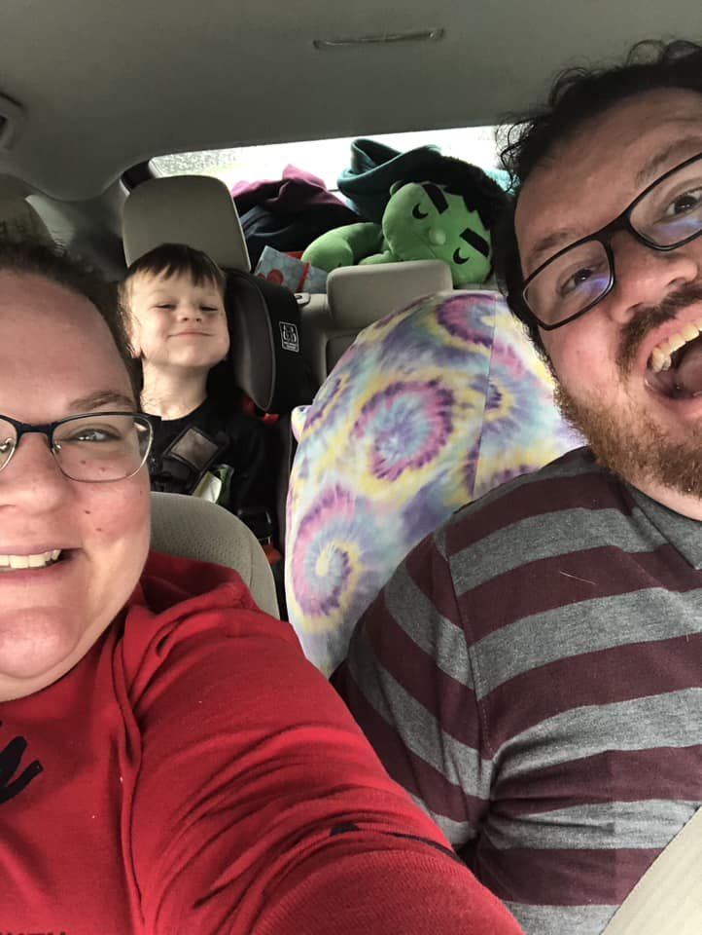
My Family
Robert, big fan of Sonic, Pokemon, & Kirby
Scott, also a history teacher (CFISD)
Loki
Who hates when I bring your essays home to grade

Slide 3
This is my 18th year teaching!
2006-2011
2011- 2013
2013 - Present

Slide 4
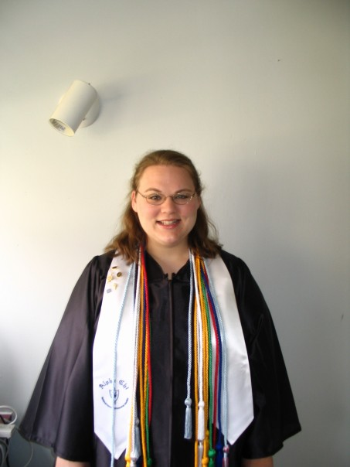
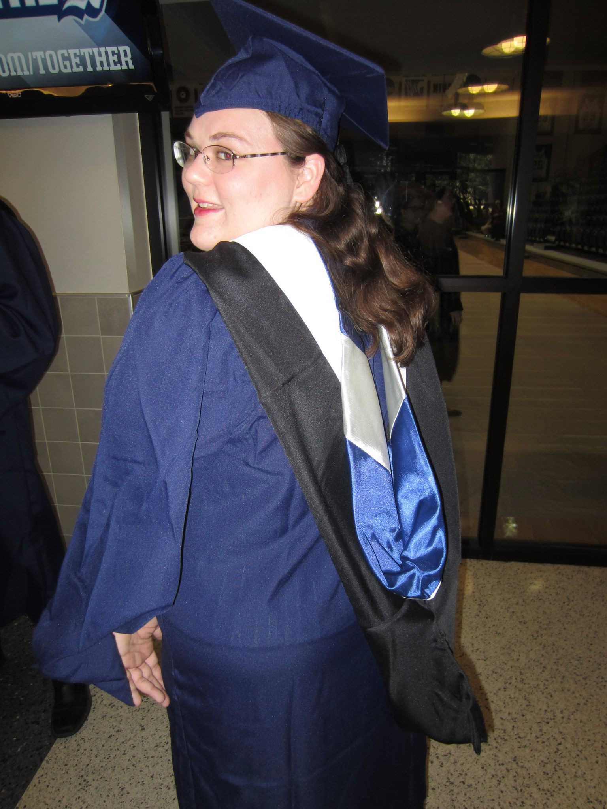
School

Slide 5
Clubs for 2024-2025!

Slide 6
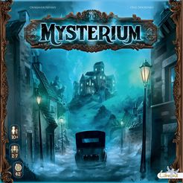
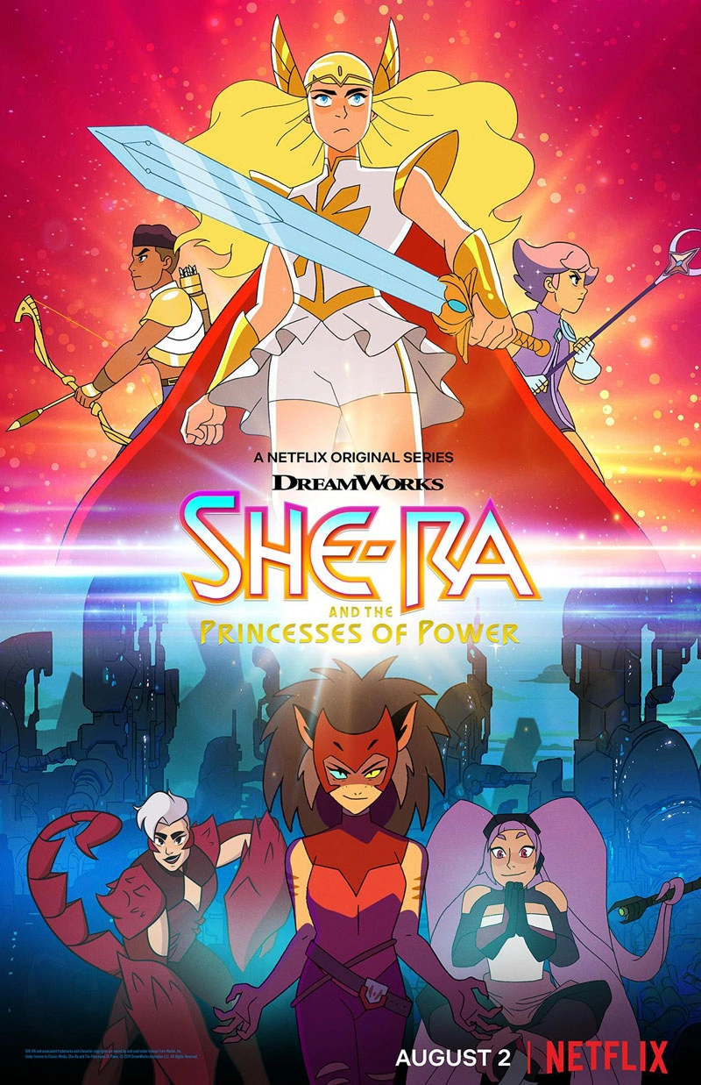
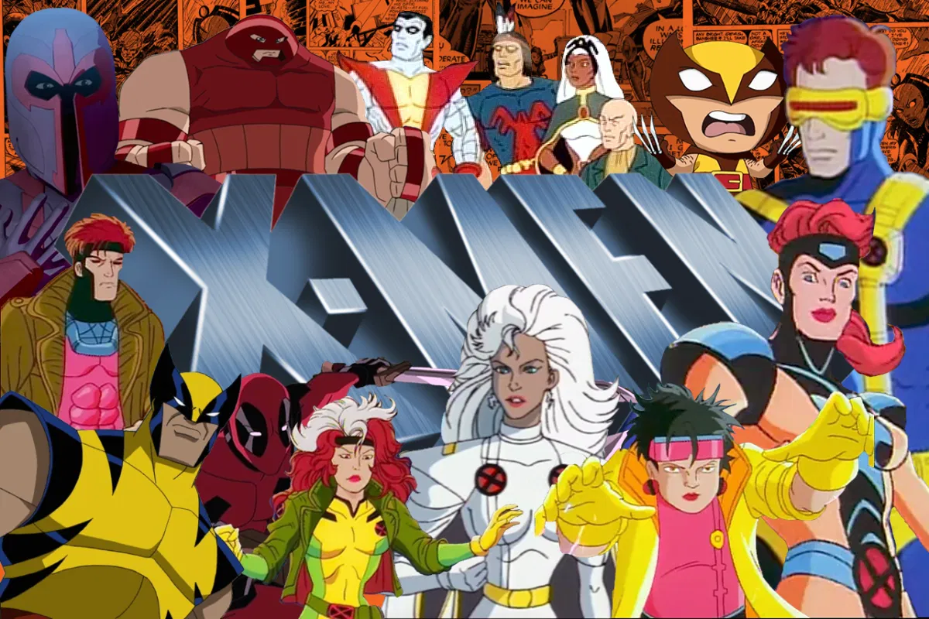
My Brand of Nerd

Slide 7
Some thoughts on teaching and studying history
If you're going to do it, do it right
Never rest on your laurels
History is almost limitless in scope and depth, if you can't find anything interesting you aren't paying attention
The most important phrase in pursuing in history is "so what"… how does it tie in? Why does it matter? Who is effected?
Understanding the world's religions is essential to becoming a global citizen, and the way into a better future

